Slide 1
fluorescence staining
2021-12-17
Zhixin Li

Slide 2
Immunofluorescence
This technique uses the specificity of antibodies to their antigen to target fluorescent dyes to specific biomolecule targets within a cell, and therefore allows visualization of the distribution of the target molecule through the sample.
Immunofluorescence can be used on tissue sections, cultured cell lines, or individual cells, and may be used to analyze the distribution of proteins, glycans 多糖, and small biological and non-biological molecules. This technique can even be used to visualize structures such as intermediate-sized filaments 架带丝.

Slide 3
basic mechanism of immunofluorescence
Primary immunofluorescence is depicted on the left, which shows an antibody with a fluorophore group bound to it directly binding to the epitope of the antigen for which it is specific. Once the antibody binds to the epitope, the sample can be viewed under fluorescent microscope to confirm the presence of the antigen in the sample.
Conversely, secondary immunofluorescence is depicted to the right, which shows that first an untagged primary antibody binds to the epitope of the antigen in a mechanism similar to the one described above. However, after the primary antibodies have bound to their target, a secondary antibody (tagged with a fluorophore) comes along. This secondary antibody's binding sites are specific for the primary antibody that's already bound to the antigen, and therefore the secondary antibody binds to the primary antibody. This method allows for more fluorophore-tagged antibodies to attach to their target, thus increasing the fluorescent signal during microscopy.

Slide 4
fluorescence microscope
The specimen is illuminated with light of a specific wavelength (or wavelengths) which is absorbed by the fluorophores, causing them to emit light of longer wavelengths (i.e., of a different color than the absorbed light). The illumination light is separated from the much weaker emitted fluorescence through the use of a spectral emission filter.

Slide 5
Photomicrograph of a histological section of human skin prepared for direct immunofluorescence using an anti-IgA antibody. The skin is from a patient with Henoch–Schönlein purpura: IgA deposits are found in the walls of small superficial capillaries 小表面的毛细血管 (yellow arrows). The pale wavy 苍白的波浪 green area on top is the epidermis 表皮, the bottom fibrous 纤维 area is the dermis 真皮.

Slide 6
A fluorescent stain for actin in the smooth muscle of the skin

Slide 7
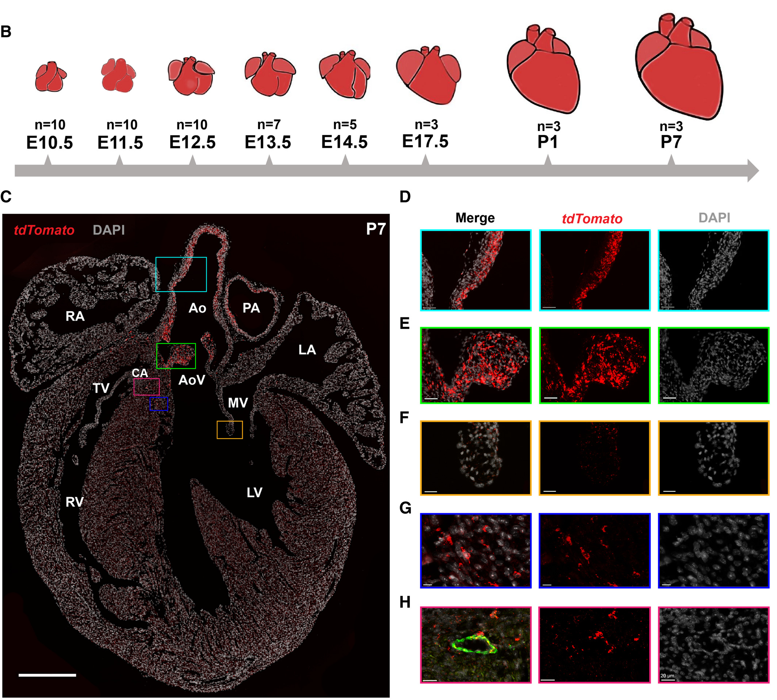
Ao, aorta;
AoV, aortic valve;
CA, coronary artery;
LA, left atrium;
LV, left ventricle;
MV, mitral valve;
PA, pulmonary artery;
RA, right atrium;
RV, right ventricle;
TV, tricuspid valve.

Slide 8
Questions
抗体为何能进入细胞内部？
抗体的选择？

Slide 9
Our lab
check control and mutant celltypes in specific tissue (gut, heart) after getting markers from scRNA-seq

Slide 10
参考：
Widefield and Confocal Fluorescence Microscopy - YT

